Slide 1
BCI - opportunities and challenges in VR application
Jessica Lai

Slide 2
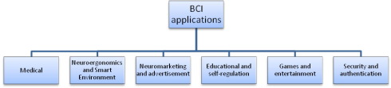
Brain computer interface
Communication pathway between users and systems
Developed with biomedical field in mind
Contribute to various fields
https://www.youtube.com/watch?v=w6QEGeIKHw0
Notes:
Build a bridge of communication between the brain and the external world using brain signals
Used for rehabilitation
The quick video to see BCI in action. Using brain to control robotic arm.
Various fields including entertainment, advertising, education, etc…

Slide 3
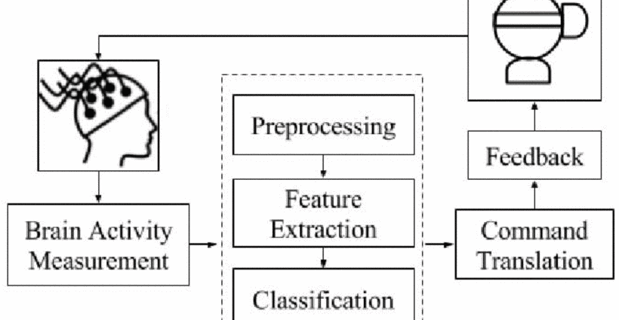
Process
Notes:
Gets brain signal,
Extract features,
Generate feedback

Slide 4
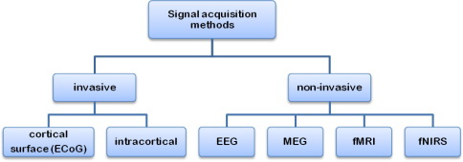
Signal acquisition
Electroencephalography (EEG) most used for VR
Notes:
In general, there are two ways to get the brain signals
Invasive – implant electrodes inside or over surface of brain. Better quality, surgical complications, restricted to medical use for disabled.
Non-invasive – Uses external sensors, to get brain activity.

Slide 5
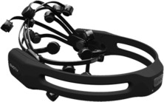
EEG
Record electrical activity along scalp
Easy to use
Portable
Cheaper
Notes:
EEG – record electrical activity along scalp to measure fluctuation in voltage generated by neurotransmission activities.
Typical view of EEG cap, with electrodes on the cap. Worn over head.
Convenient and recommended for commercial use.
High temporal resolution but limitations in signal/noise ratio and spatial resolution.

Slide 6
Preparations
Personal training to control signals
Data training – recongization and classification
Notes:
Problem. How do we know what to look for?
Train people to consciously control their brain signals in a BCI system. Usually reinforcement learning games
Using data collected, train a machine learning model that can recognize and classify the patterns you are interested in.
This model will be used to extract the features in testing and applications.

Slide 7
EEG based BCI model
Notes:
Brain Activity Measure – first step, make sure EEG is picking up signals
Preprocessing – dampen noise in data. Filtering, segmentation, detrend. Data is separated where brain waves overlap and labeled in to stimulus or response.
Feature extraction – finding the signals you are interested in. This is the most important part of the process.
Classification – assign correct class label to the features you extracted. Class labels represent intention of user. could use simple linear models or even neural networks. Classification is used the most
Command translation – issue command based on intention.
Feedback – results of command is reflected to virtual environment. Users sees this feedback and can adjust the brain activity to increase accuracy.

Slide 8
Classification and machine learning
Speed is key
Linear Classifiers
Linear Discriminant Analysis (LDA)
Support Vector Machine (SVM)
Non-liner Classifiers
Support Vector Machine (SVM)
K – nearest neighbors (KNN)
Neural Networks
Notes:
For real time update, classification algorithm have to be fast. (offline models don’t need this)
Linear – distinguish classed with in linear function
LDA – most popular. Use hyper planes to separate classes of data. Good accuracy and doesn’t require high computations.
SVM – optimally select hyperplanes. Uses regularization to deal with noise.
Non-linear –
SVM – more flexible than linear through use of kernel trick. Fast enough for real time BCI
KNN – distinguish features corresponding to different classes to form separate clusters. Cloest are same class. Less prone to error.
Neural networks – most common in BCI. Universally approximate any continuous function. Multiple layers of perceptrons.

Slide 9
Software frameworks
BCI2000
OpenViBE
BCILAB
BioSig
Notes:
All of these offer packages for data acquisition, feature extraction, classification and feedback presentation.
Some are independent, BCILAB and BioSig works with Matlab

Slide 10
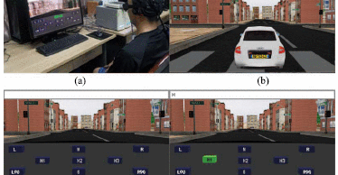
applications
Notes:
Driving in a virtual city.

Slide 11
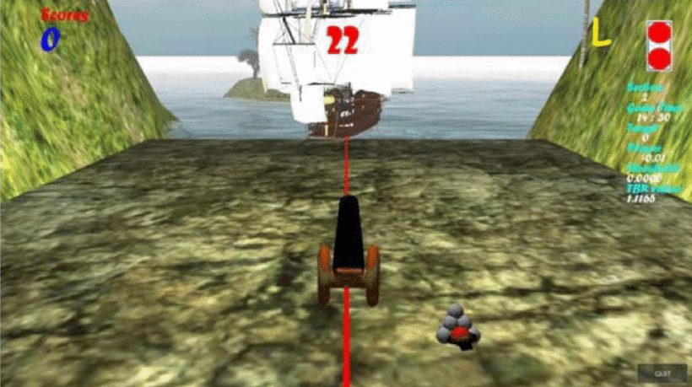
applications
Notes:
Interactive VR game for upper limb post-stroke rehabilitation (BCI for attention monitoring, provide stimulation when attention is low)

Slide 12
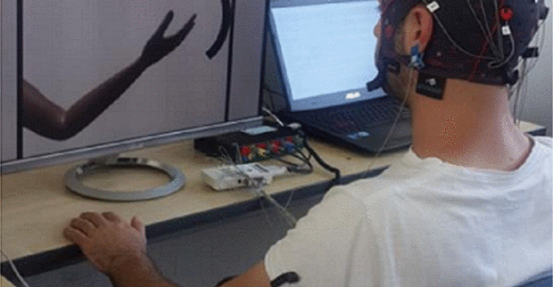
applications
Notes:
Also upper limb rehabilitation – direct control.

Slide 13
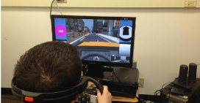
applications
Notes:
Autism prevention – EEG feedback to therapist in separate room

Slide 14
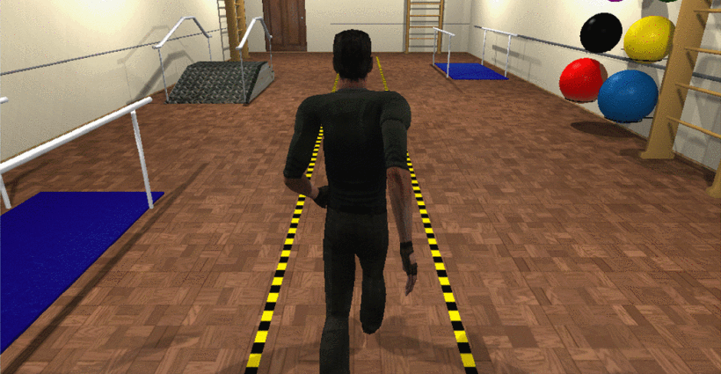
applications
Notes:
BCI to control an avatar in VR – offline model

Slide 15
opportunities
Remove limitation of user input in VR
Expansion into immersive VR
User state monitoring
Notes:
The scope of user input would be unlimited just as the scope of the virtual world. Would not be restricted by number of controller combinations or limited context per situation for gaze based input.
Current BCI efforts are all in non-immersive VR. If head mounted become less bulky, could potentially have both. Closer to the sense of true immersion.
BCI can also be used to monitor mental state of users. This can be applied on top of curing phobias and for trainings or games in dangerous situation as an extra precaution to the user is safety.

Slide 16
Challenges
Usability
Lack of convenience
No common ground for commands
Is it really ethical?
Technical difficulties
Notes:
BCI is not convenient. Calibration can take from 5 to 20 minutes. It maybe simply too much trouble for what it’s worth.
Although there are little studies here and there, there is nothing even resembling a common set of command that would work for most people at this early stage. Remember that the model used is pre-trained to get the specific signal required.
BCI exposes a person’s thoughts and therefore may not be completely ethical in the sense of mind privacy.
There is still a long way to go before BCI devices could be seamlessly integrated as well as a controller would in todays world. Hardware would need to be more convenient to use, comfortable, cheaper, and faster to setup.
Current BCI is a synchronous process, but people’s thinking process is not that way. Possible integration into asynchronous would be better.

Slide 17
References
[1] Sarah N. Abdulkader, Ayman Atia, Mostafa-Sami M. Mostafa, Brain computer interfacing: Applications and challenges, In Egyptian Informatics Journal, Volume 16, Issue 2, 2015, Pages 213-230.
[2] S. Li, A. Leider, M. Qiu, K. Gai and M. Liu, "Brain-Based Computer Interfaces in Virtual Reality," 2017 IEEE 4th International Conference on Cyber Security and Cloud Computing (CSCloud), New York, NY, 2017, pp. 300-305.
[3] X. Pan, Z. Zhang, J. Qu, C. Zhao and Y. Li, "Enjoy driving from thought in a virtual city," 2017 36th Chinese Control Conference (CCC), Dalian, 2017, pp. 11034-11040.
[4] B. S. Lin, H. C. Hsu, G. E. Jan and J. L. Chen, "An Interactive Upper-Limb Post-Stroke Rehabilitation System Integrating BCI-based Attention Monitoring and Virtual Reality Feedback," 2016 Third International Conference on Computing Measurement Control and Sensor Network (CMCSN), Matsue, 2016, pp. 44-47.
[5] D. Achanccaray, K. Acuña, E. Carranza and J. Andreu-Perez, "A virtual reality and brain computer interface system for upper limb rehabilitation of post stroke patients," 2017 IEEE International Conference on Fuzzy Systems (FUZZ-IEEE), Naples, 2017, pp. 1-5.
[6] J. Fan et al., "A Step towards EEG-based brain computer interface for autism intervention," 2015 37th Annual International Conference of the IEEE Engineering in Medicine and Biology Society (EMBC), Milan, 2015, pp. 3767-3770.
[7] B. B. Longo, A. B. Benevides, J. Castillo and T. Bastos-Filho, "Using Brain-Computer Interface to control an avatar in a Virtual Reality Environment," 5th ISSNIP-IEEE Biosignals and Biorobotics Conference (2014): Biosignals and Robotics for Better and Safer Living (BRC), Salvador, 2014, pp. 1-4.
[8] J. van Erp, F. Lotte and M. Tangermann, "Brain-Computer Interfaces: Beyond Medical Applications," in Computer, vol. 45, no. 4, pp. 26-34, April 2012.

